Slide 1

Fire Watch
Using Convolutional Neural Networks to Prevent Wildfires
Carter Elliott & Steven Nguyen in Partnership with Perimeter Platform

Slide 2
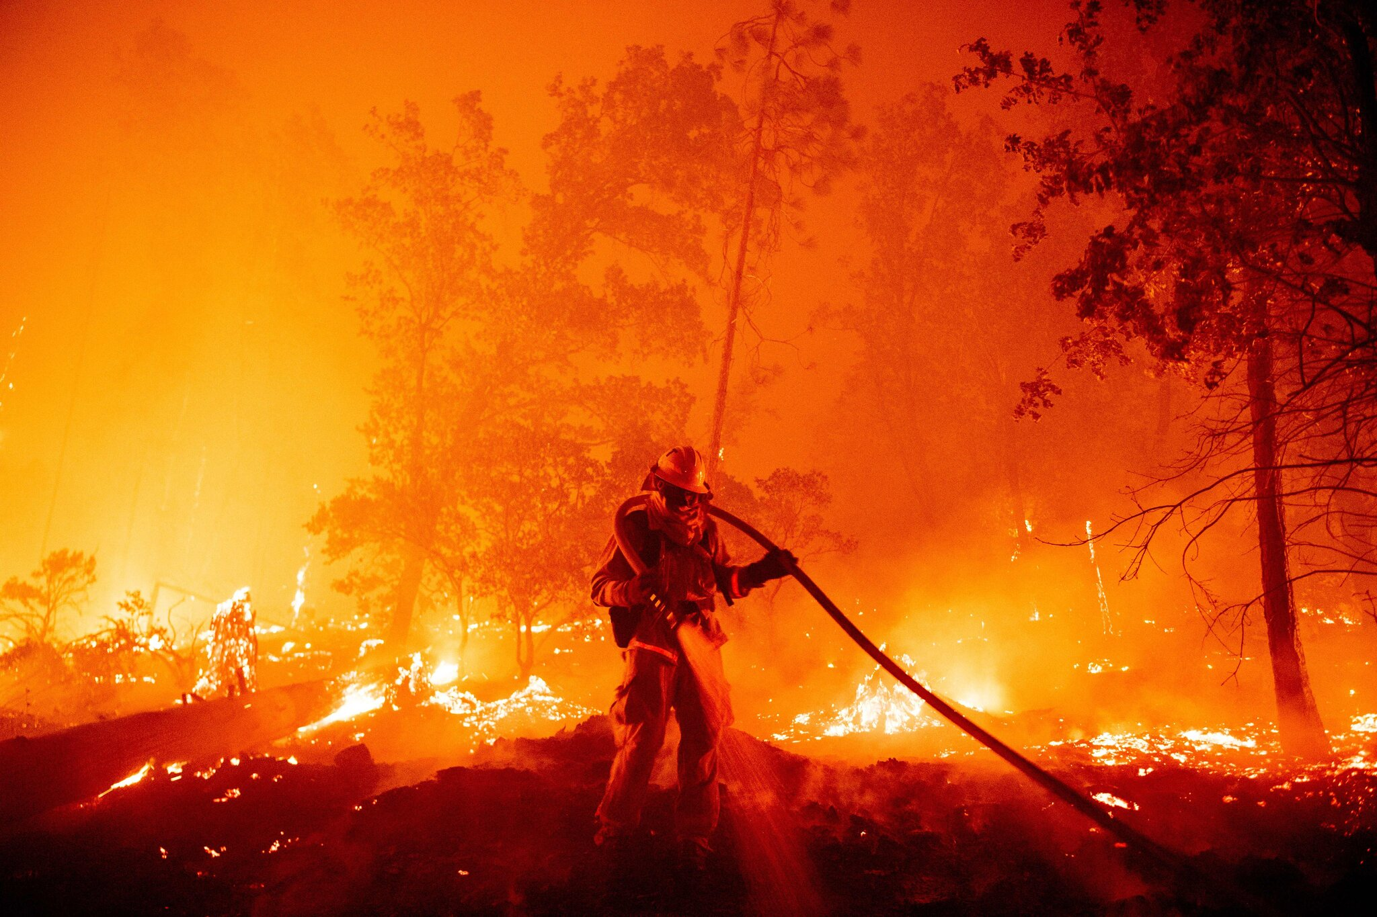
Wildfires: A Wildly Complex Problem
California droughts dried out landscape
Most intense drought happened from December 27, 2011 to March 5, 2019
https://www.drought.gov/states/california
Made wildfire conditions more favorable
Climate Change has increased intensity of wildfires
Increased temperatures of fires
Dried land has increased duration of wildfires
8 of top 10 wildfires in California have happened in the past decade
https://www.fire.ca.gov/media/4jandlhh/top20_acres.pdf
Massive Impacts
Environmental damage
Economic turmoil
Social impacts

Slide 3
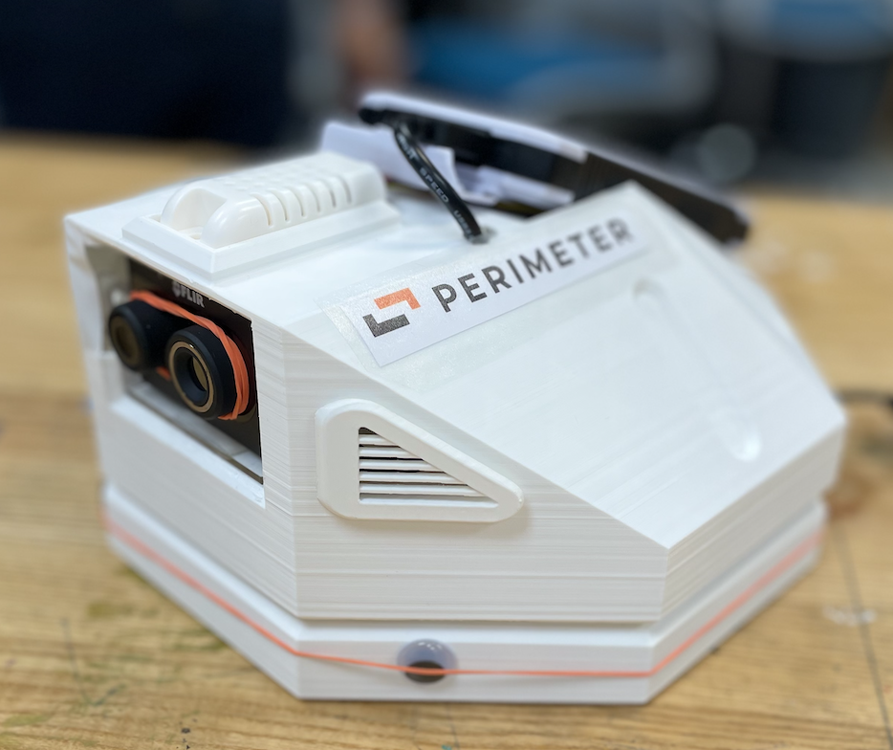
Experimental Fire Sensor
Partnered with Perimeter Platform to design Thermal Image Fire Sensor
Process:
1. Uses FLIR Thermal Image camera to take images
2. Images sent to web using AWS S3 Bucket
3. Images can be accessed from anywhere around the world (via Google Maps)
Perimeter Platform
Independent data sharing platform that focus on pushing real-time data to first responders and users as quickly as possible
Based in Oakland, California
https://perimeterplatform.com/

Slide 4
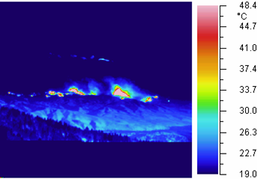
CNN for For Prevention
CNN can allow for identification of fires in thermal images
Detect “hot spots” in photos of wilderness - “hot spots” indicate fires
Save time and resources
Allows first responders to respond to fires before they get out of control
Can be implemented anywhere
First Responder Command Centers
Mobile Firefighting Units
Thermal Image Fire Sensors

Slide 5
Solution: Create CNN for Fire Sensor
Fire Sensor is currently limited
Can only send images, with no image analysis
No alert if a fire is spotted
Adding a thermal image CNN will allow for the following:
Real-time image analysis - saves time and resources
Provide alerts and notifications if fires are spotted
Allows for early action
Increase usability and functionality of current Fire Sensor
Future Teams will Embed Model
This project started in ISAT 437, future teams will hopefully implement this model in the future
Main Goal: Create a CNN that can spot “hot spots” in thermal images

Slide 6
Issues Faced (11/2/21 to 11/9/21)
We have found a potential dataset to train our model to train our model on; however, it’s only comprised of thermal images of random things, not fires.

Slide 7
Accomplishments (11/2/21 to 11/9/21)
The team was created
The project has been refined to a more realistic goal
We have found a potential dataset to use

Slide 8
Accomplishments (Prior to 11/2/21)
We have created and refined our idea for what we wanted to do
We have talked to Teate, and gotten his approval on the topic
We have reached out to Perimeter (the company that Carter worked on the fire sensor for) and they have agreed to team up and be a point of support as needed

Slide 9
Tasks to Accomplish (11/9/21 to 11/16/21)
Define the parameters that we want for our CNN to work with ( what is the threshold it needs to hit before a notification is sent out)
Potentially meet with Bailey and Noah from Perimeter to obtain dataset and update progress
Start doing data preprocessing with Thermal Image Dataset (in case we can’t obtain a fire thermal image dataset)

Slide 10
Areas of Further Research/Exploration
How have Convolutional Neural Networks been used for firefighting in the past?
Have any Convolutional Neural Networks for firefighting been used in the real world?
What impact would this kind of technology have on the firefighting landscape?

